Slide 1




Controlling Permissions to Azure SQL Database and Azure SQL Managed Instance using Excel and Azure DevOps
Rob Sewell - @SQLDbaWithBeard

Slide 2
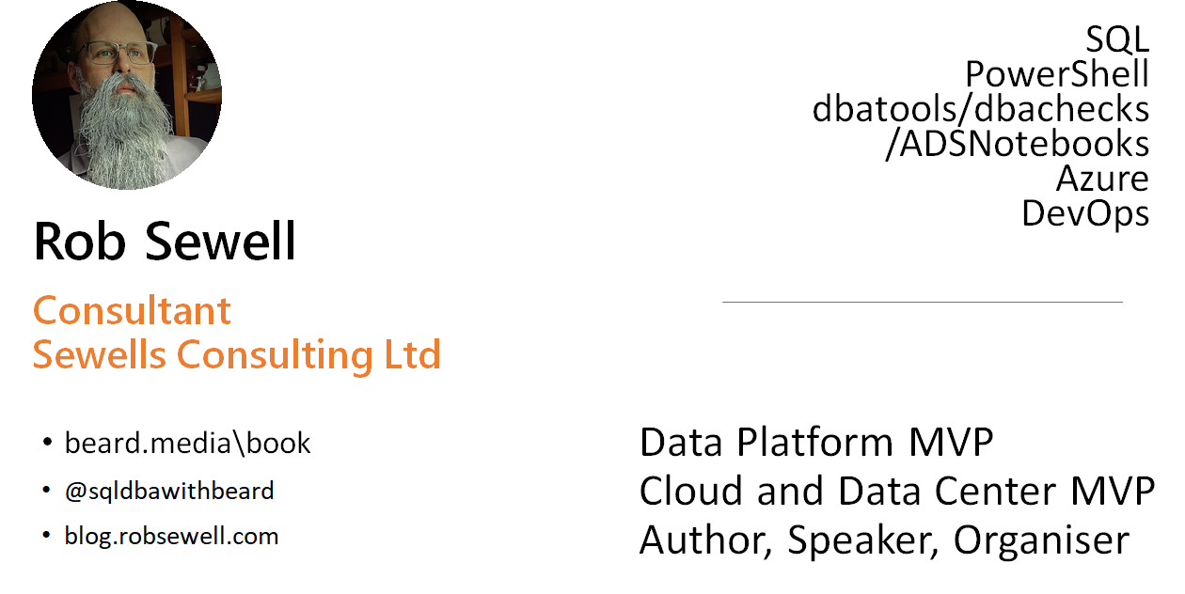

Slide 3

What Is The Problem ?
Photo by Andrey Metelev on Unsplash

Slide 4
What Is The Problem ?
Automate a solution to make it easy for the Operational Team to control permissions to the Azure SQL Database and Azure SQL Managed Instance estate
Photo by Andrey Metelev on Unsplash

Slide 5
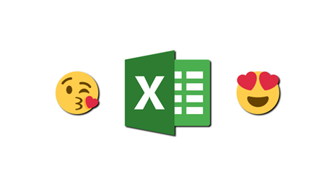
Also
“We’d Really like to use Excel”

Slide 6
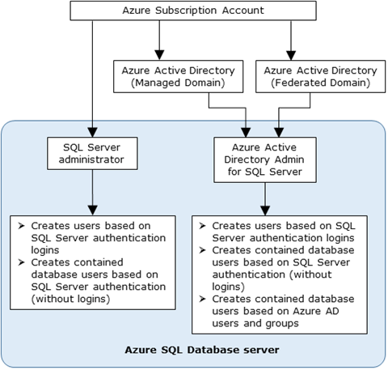
Creating Azure SQL Database Users
Admin Accounts can create
https://docs.microsoft.com/en-us/azure/azure-sql/database/authentication-aad-overview

Slide 7


Creating Azure SQL Database Users
https://docs.microsoft.com/en-us/azure/azure-sql/database/authentication-aad-overview

Slide 8

Only One Option
Photo by Olli Kilpi on Unsplash

Slide 9

Creating an AAD Contained Database User
We have an automated Infrastructure as Code deployment
We want an automated Permissions as Code pipeline
We don’t want manual intervention
Photo by Thirteen .J on Unsplash

Slide 10
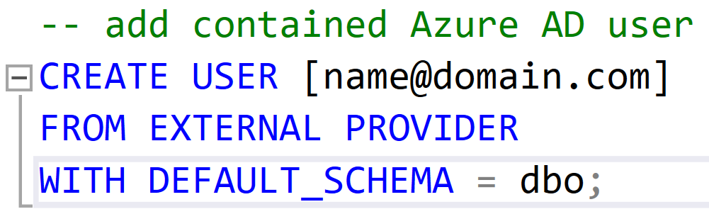
Creating an AAD Contained Database User
Only connections established with Active Directory accounts can create other Active Directory users

Slide 11

Apply Permissions using SPN
Azure SQL Server Identity
Active Directory Admin
Requirements
Directory Readers Role
Azure DevOps Pipeline
Permissions in Excel Sheet
Photo by Kelly Sikkema on Unsplash

Slide 12
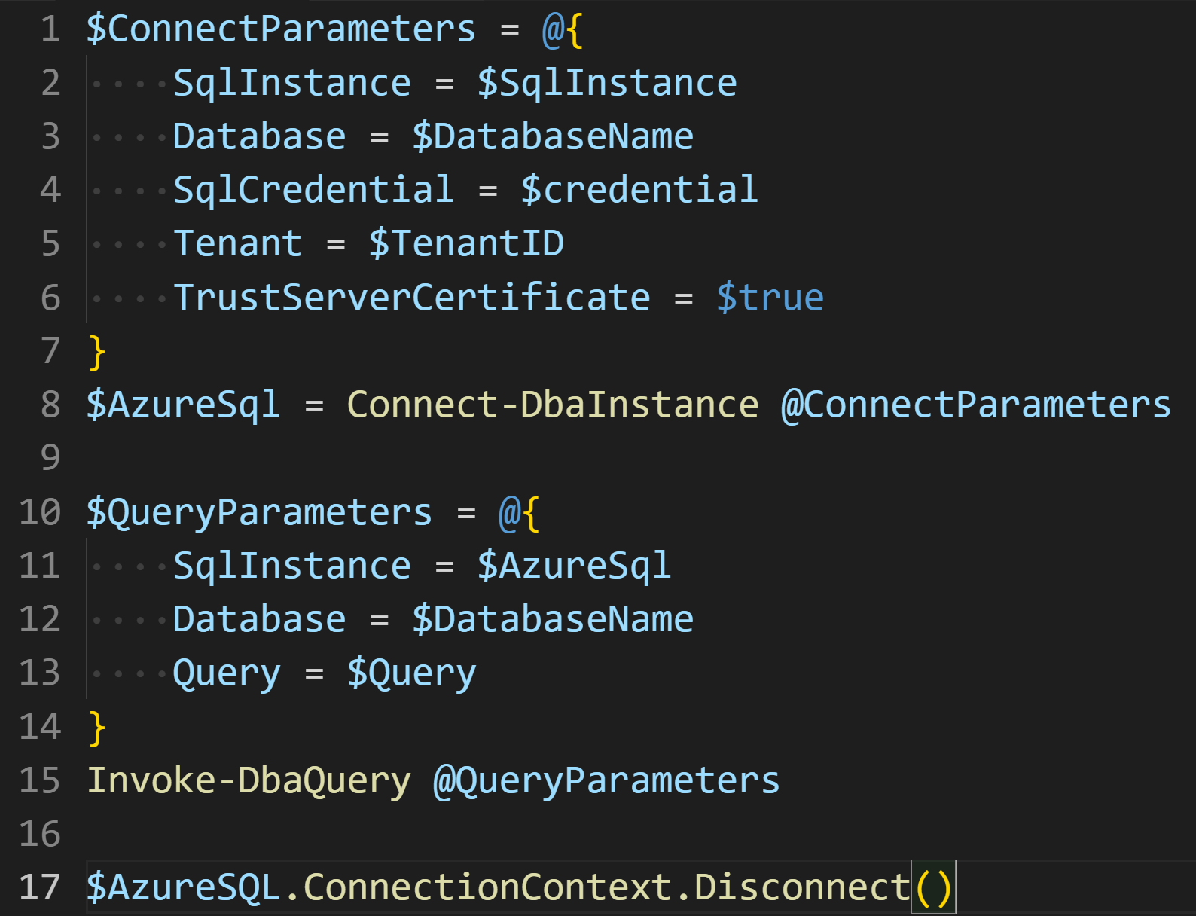
Need to login as the SPN to run the T-SQL
Use dbatools https://dbatools.io

Slide 13
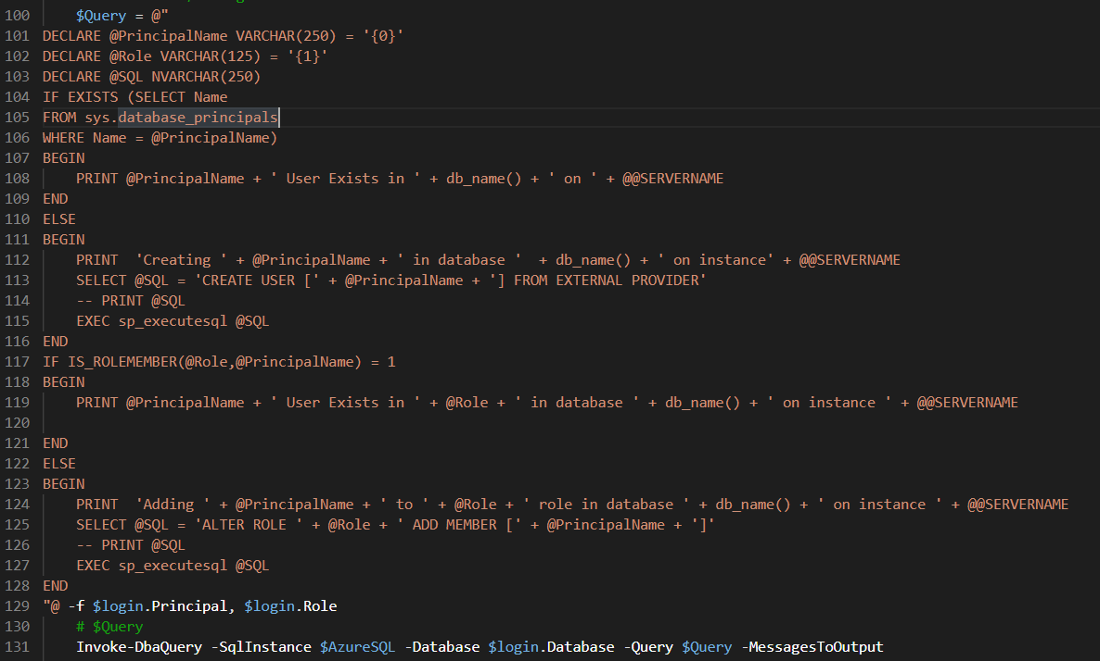

Slide 14

Apply Permissions using SPN
Azure SQL Server Identity
Active Directory Admin
Requirements
Directory Readers Role
Azure DevOps Pipeline
Permissions in Excel Sheet
Photo by Kelly Sikkema on Unsplash

Slide 15
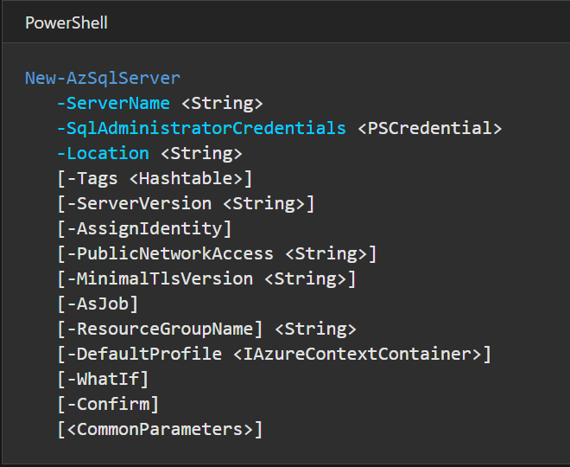
Need the SQL Server to have an Identity
https://docs.microsoft.com/en-us/powershell/module/az.sql/new-azsqlserver?view=azps-5.4.0

Slide 16
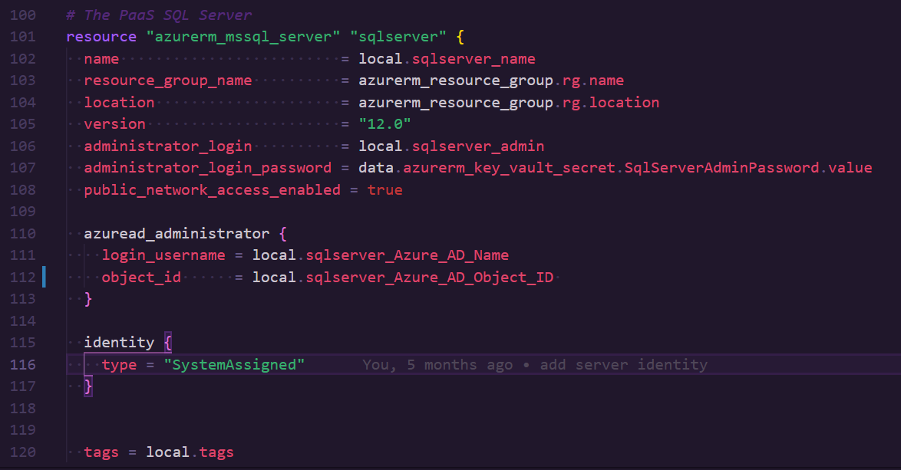
Need the SQL Server to have an Identity
https://registry.terraform.io/providers/hashicorp/azurerm/latest/docs/resources/sql_server

Slide 17
Apply Permissions using SPN
Azure SQL Server Identity
Active Directory Admin
Requirements
Directory Readers Role
Azure DevOps Pipeline
Permissions in Excel Sheet
Photo by Kelly Sikkema on Unsplash

Slide 18
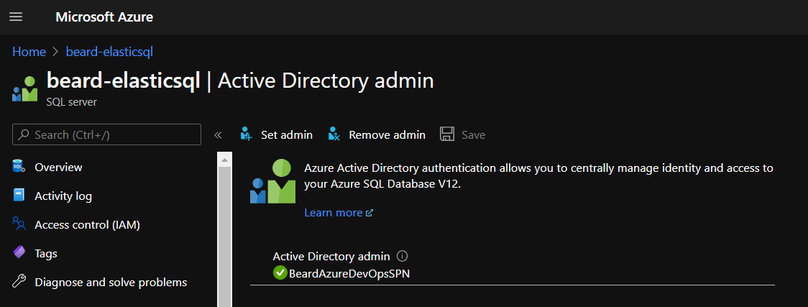
Set the Active Directory Admin

Slide 19
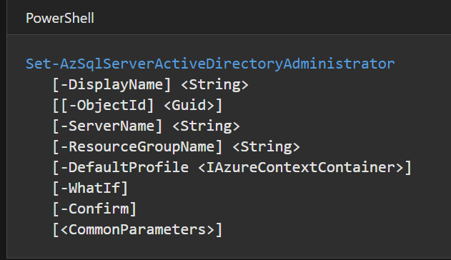
Set the Active Directory Admin
https://docs.microsoft.com/en-us/powershell/module/az.sql/set-azsqlserveractivedirectoryadministrator?view=azps-5.4.0

Slide 20
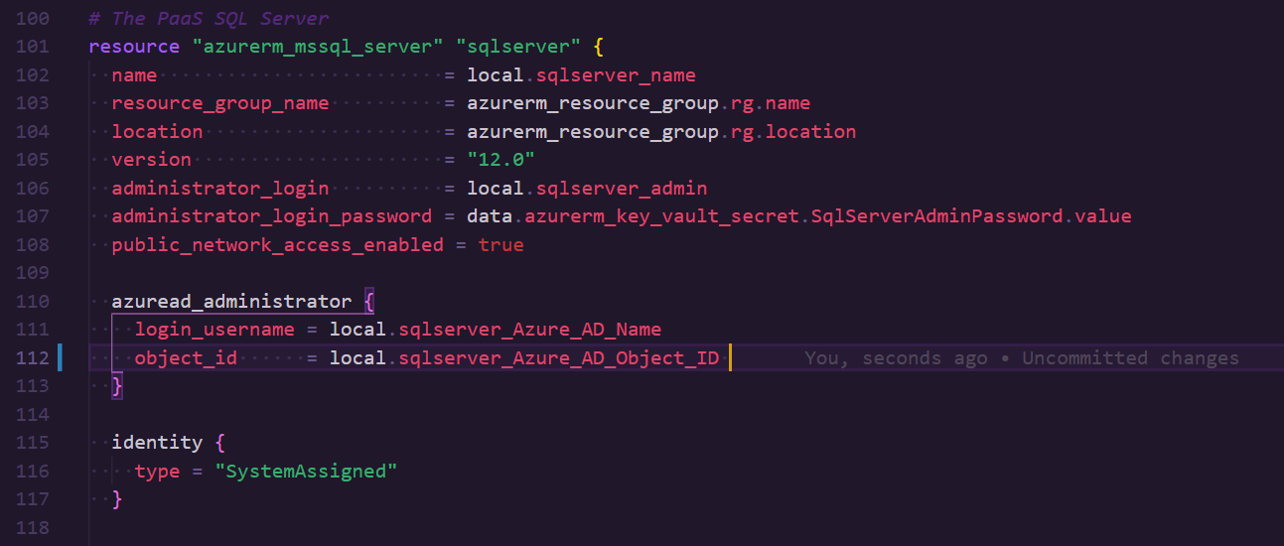
Set the Active Directory Admin
https://registry.terraform.io/providers/hashicorp/azurerm/latest/docs/resources/sql_server

Slide 21
Apply Permissions using SPN
Azure SQL Server Identity
Active Directory Admin
Requirements
Directory Readers Role
Azure DevOps Pipeline
Permissions in Excel Sheet
Photo by Kelly Sikkema on Unsplash

Slide 22
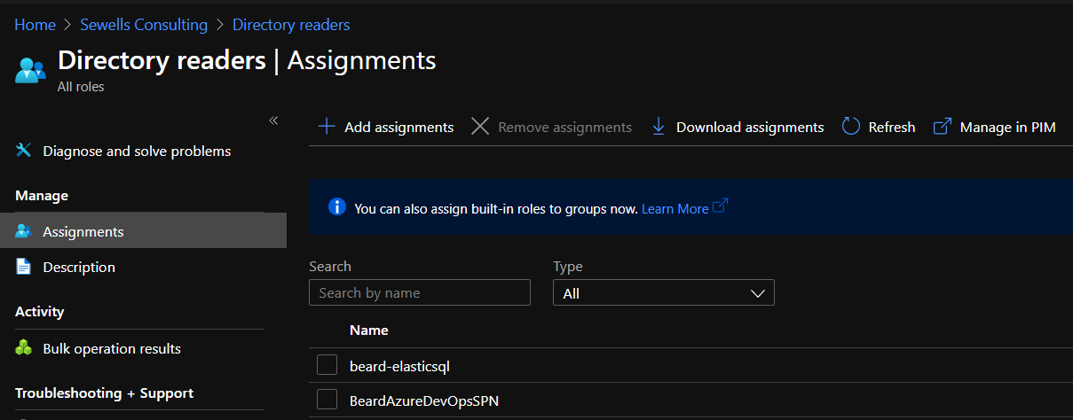
Directory Reader in AAD

Slide 23
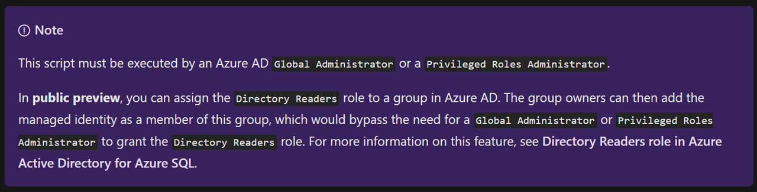
Directory Reader in AAD
https://docs.microsoft.com/en-us/azure/azure-sql/database/authentication-aad-service-principal-tutorial

Slide 24
Apply Permissions using SPN
Azure SQL Server Identity
Active Directory Admin
Requirements
Directory Readers Role
Azure DevOps Pipeline
Permissions in Excel Sheet
Photo by Kelly Sikkema on Unsplash

Slide 25
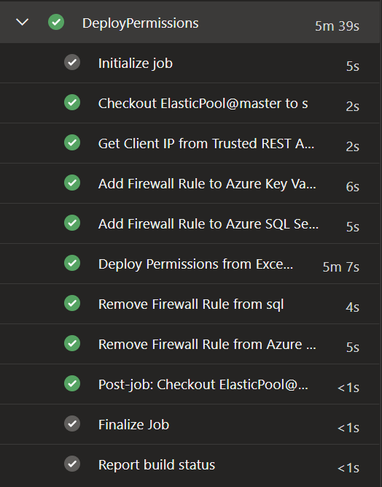
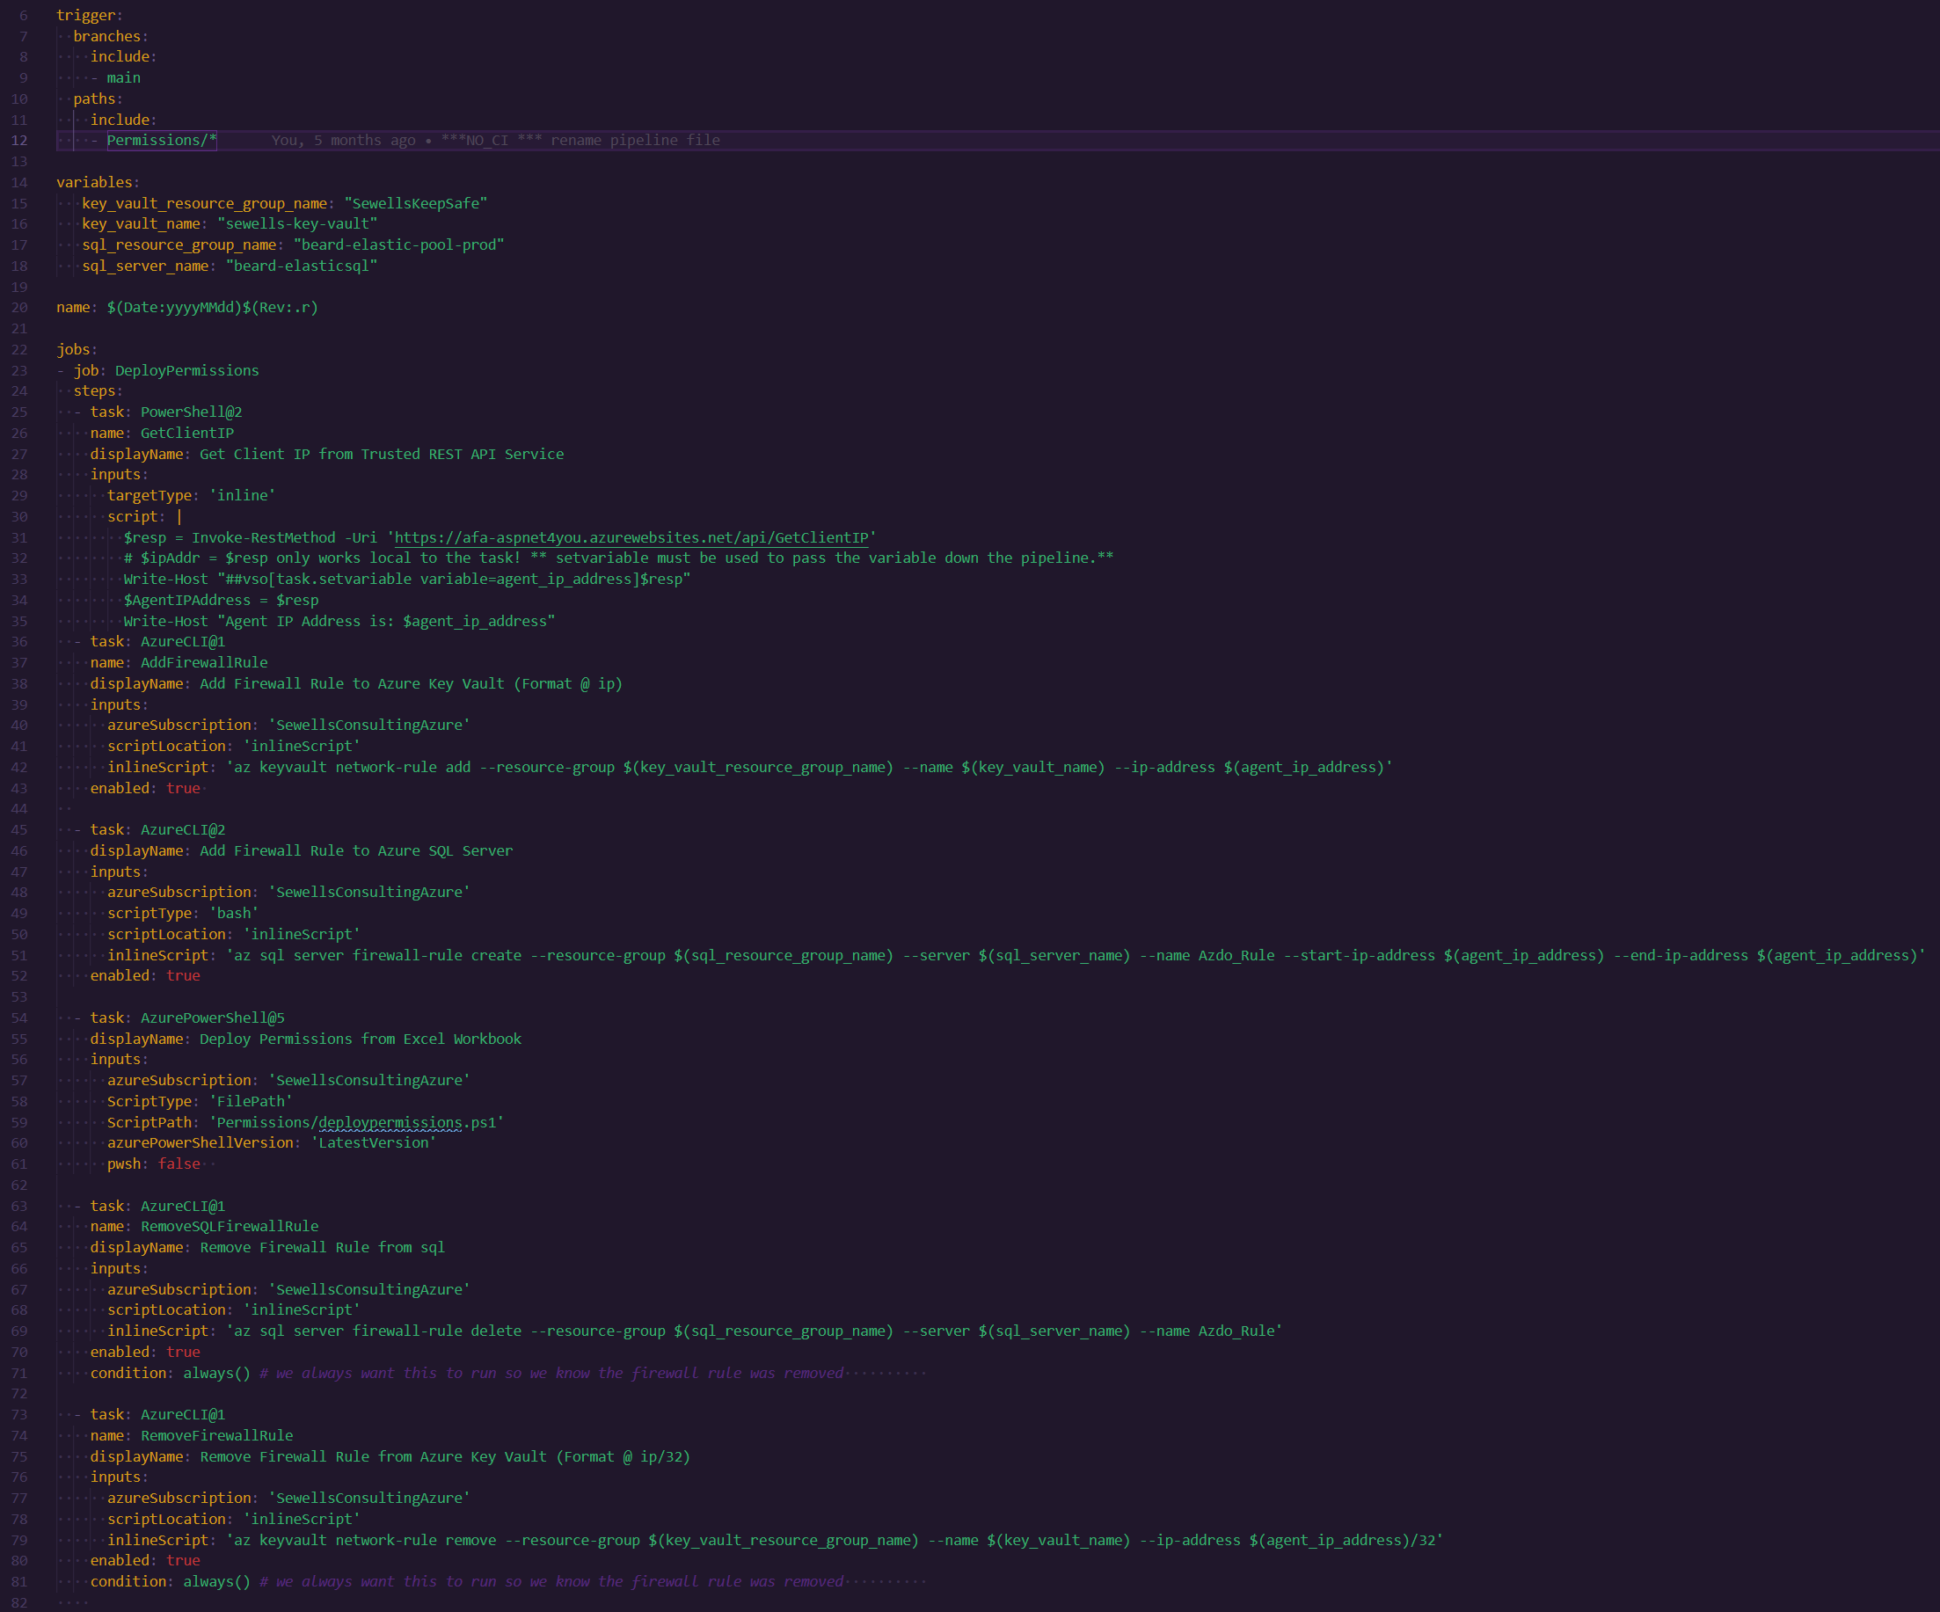

Slide 30
Apply Permissions using SPN
Azure SQL Server Identity
Active Directory Admin
Requirements
Directory Readers Role
Azure DevOps Pipeline
Permissions in Excel Sheet
Photo by Kelly Sikkema on Unsplash

Slide 31
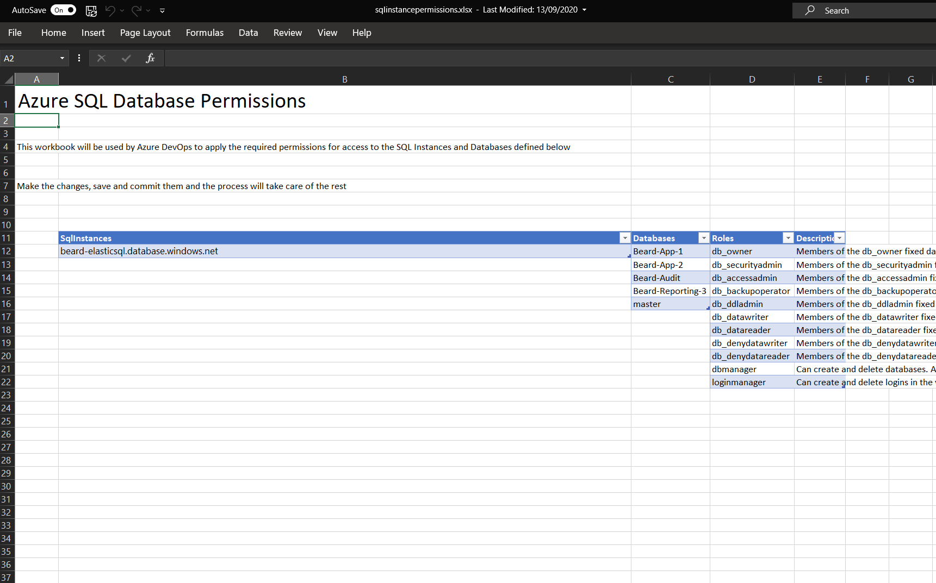

Slide 32
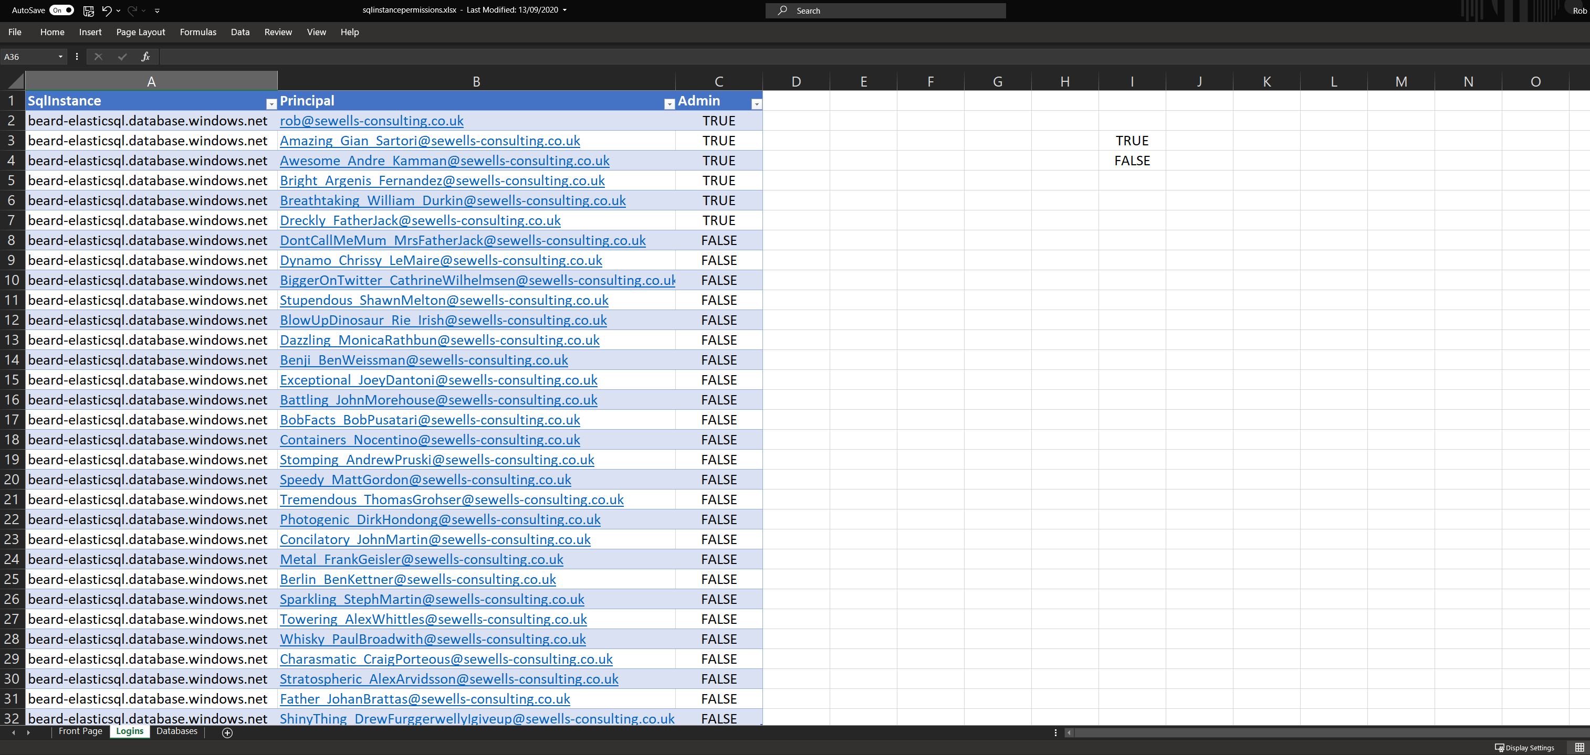

Slide 33
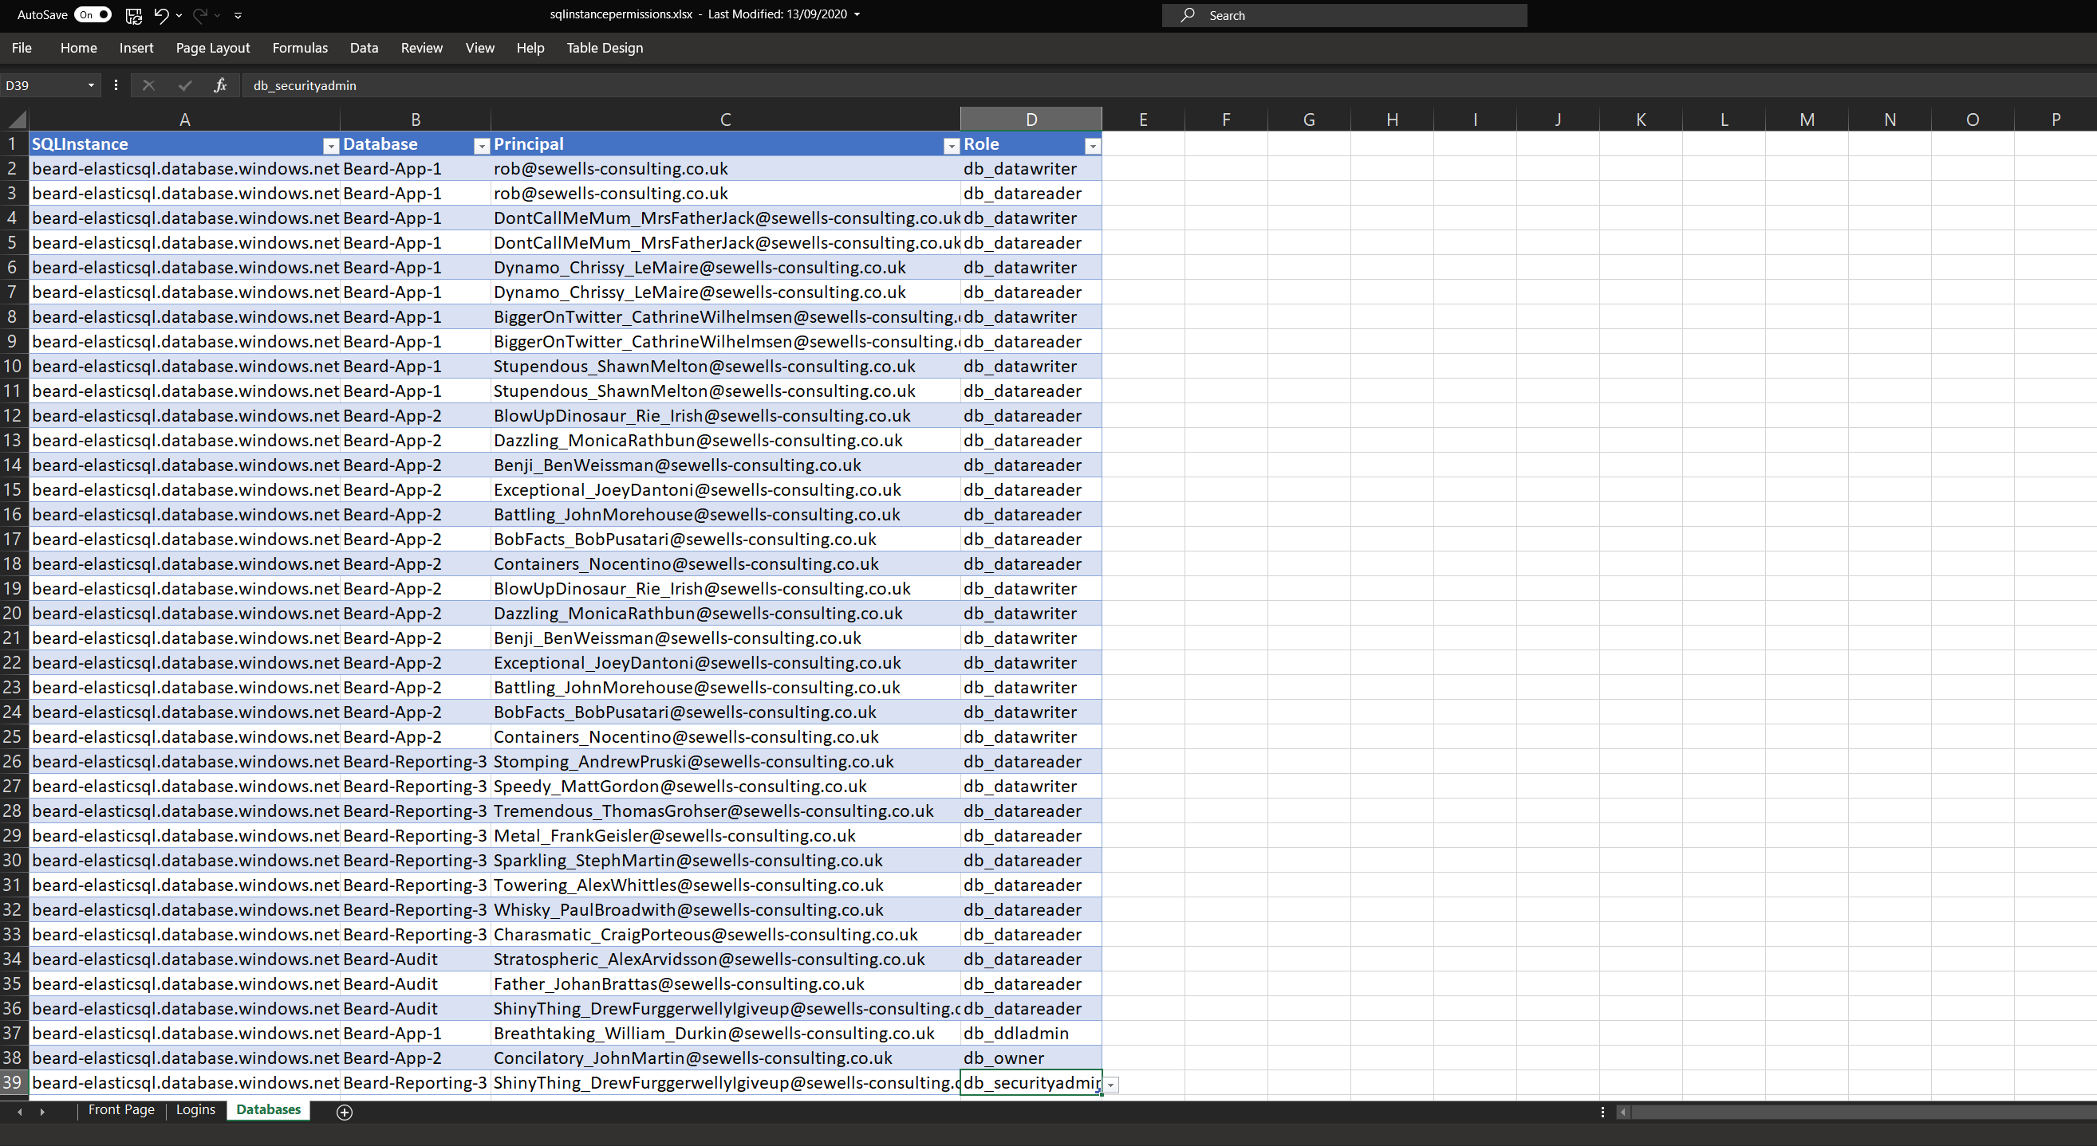

Slide 34
Apply Permissions using SPN
Azure SQL Server Identity
Active Directory Admin
Requirements
Directory Readers Role
Azure DevOps Pipeline
Permissions in Excel Sheet
Photo by Kelly Sikkema on Unsplash

Slide 35
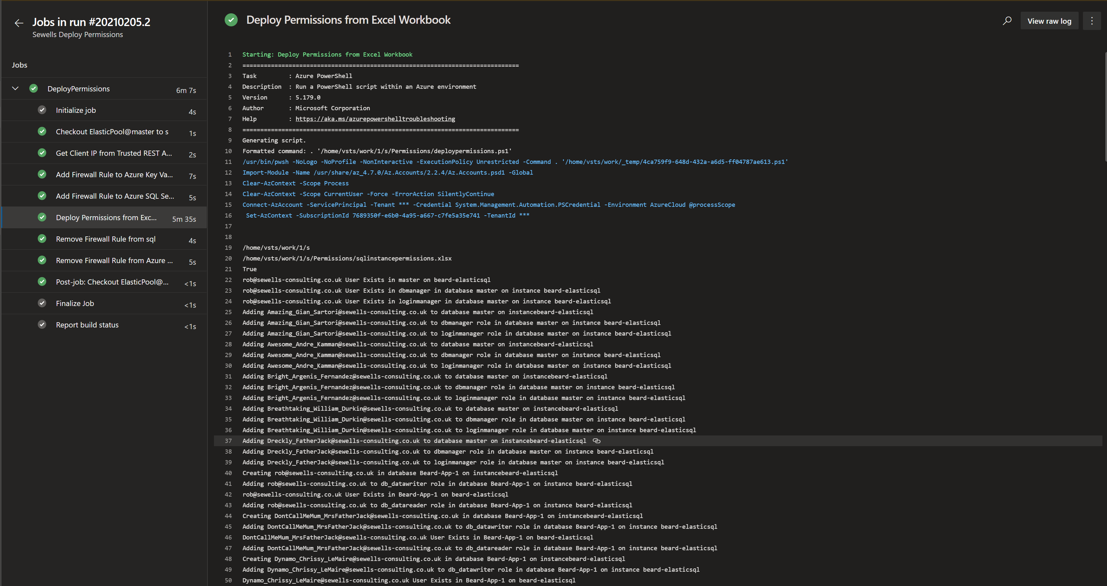
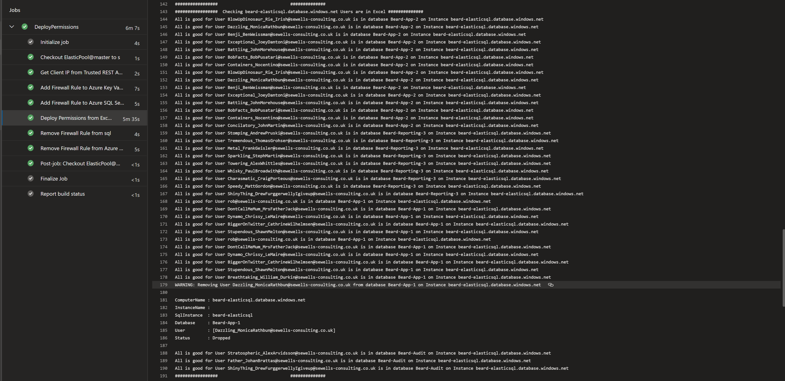
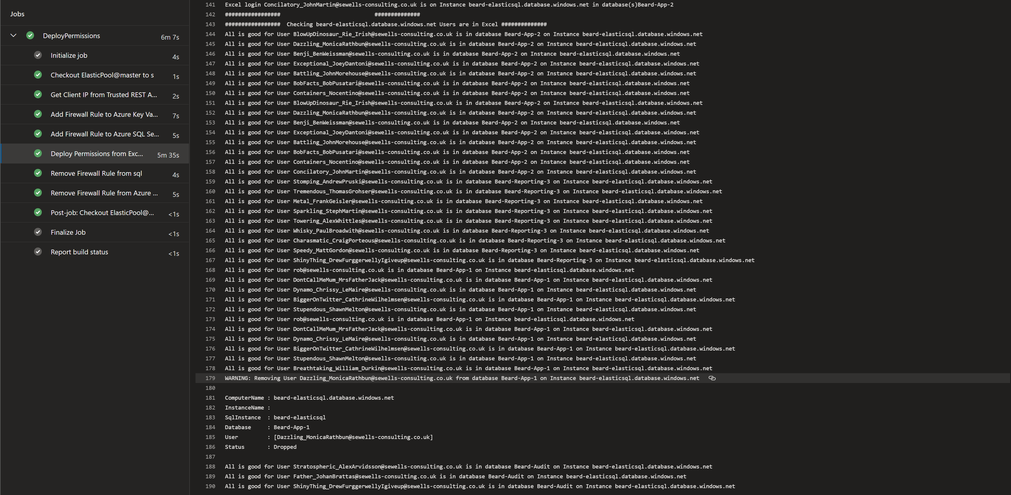
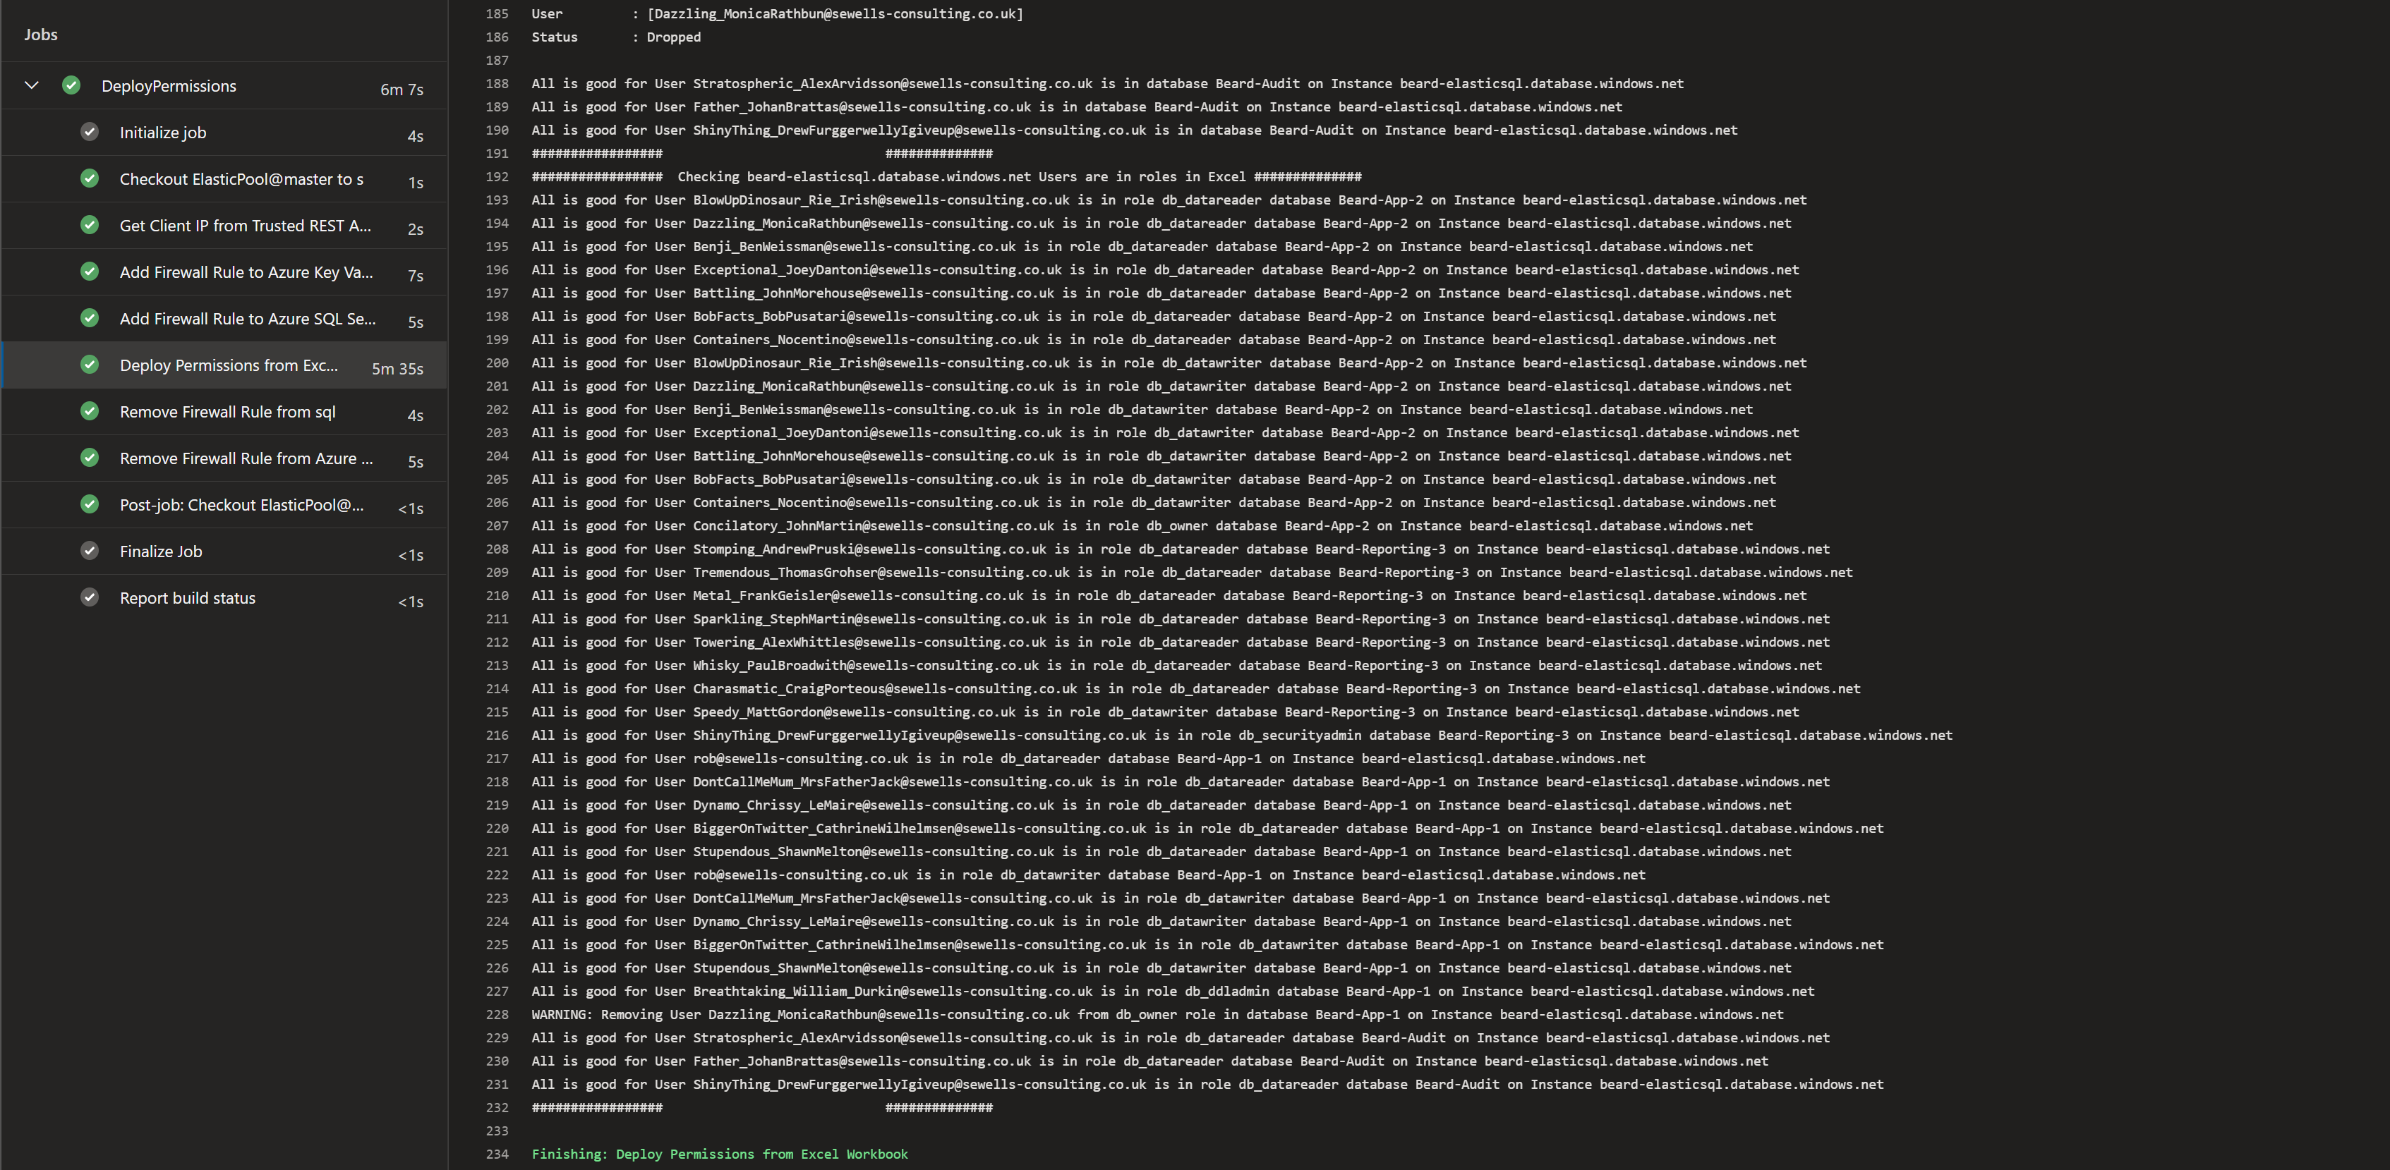

Slide 39
So now we have all that we need
•An Excel File for Permissions
•Azure SQL instance with AAD Identity and SPN with Directory Reader
•dbatools to run the query
•Azure Key Vault for storing secrets
•Azure DevOps for running the code

